Slide 1
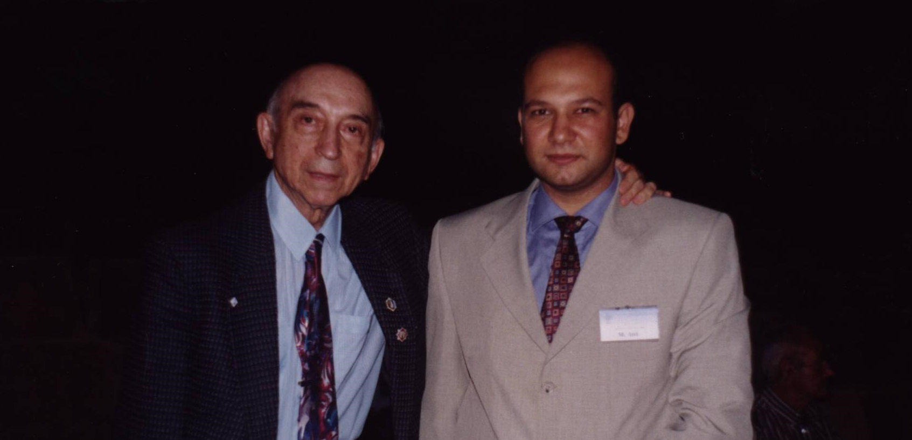
FUZZY LOGIC
Prof.Dr. Lotfi Asker Zadeh anısına
Doğum : 1927 Bakü/ Azerbaycan
Vefat : 2017 Berkeley / California

Slide 2
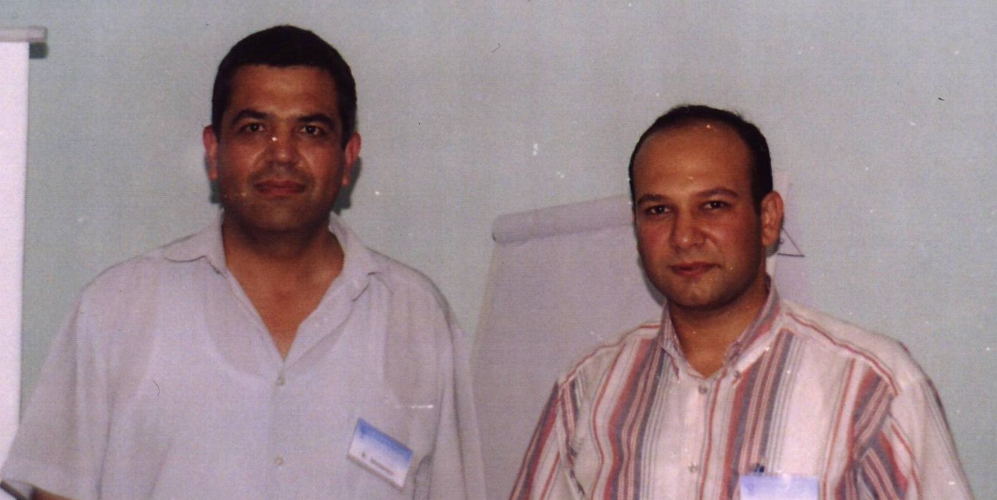
Prof.Dr. Krassimir ATANASOV
Varna/Bulgaristan 2002

Slide 3
OVERVIEW
Introduction
Bit of History
Fuzzy Sets
Fuzzy Representation
Linguistic Variables
Membership Functions
Fuzzy Logic Operators
Fuzzy Logic System
Fuzzy Inference System
Mamdani’s Method
Sugeno’s Method
Applications
Advantages and Disadvantages of Fuzzy Logic

Slide 4
Introduction
Definition of fuzzy
Fuzzy – “not clear, distinct, or precise; blurred”
Definition of fuzzy logic
A form of knowledge representation suitable for notions that cannot be defined precisely, but which depend upon their contexts.

Slide 5
A bit of History
Traces back to Ancient Greece
Lotfi Asker Zadeh ( 1965 )
First to publish ideas of fuzzy logic.
Professor Toshire Terano ( 1972 )
Organized the world's first working group on fuzzysystems.
F.L. Smidth & Co. ( 1980 )
First to market fuzzy expert systems

Slide 6
More Definition
Fuzzy logic is a set of mathematical principles for knowledge representation based on degrees of membership.
Unlike two-valued Boolean logic, fuzzy logic is multi-valued. It deals with degrees of membership and degrees of truth.
Fuzzy logic uses the continuum of logical values between 0 (completely false) and 1 (completely true). Instead of just black and white, it employs the spectrum of colours, accepting that things can be partly true and partly false at the same time.
0
0
1
1
0
0.2
0.4
0.6
0.8
1
(a) Boolean Logic.
(b) Multi-valued Logic.

Slide 7
Crisp vs. Fuzzy Sets
The classical example in fuzzy sets is tall men. The elements of the fuzzy set “tall men” are all men, but their degrees of membership depend on their height.

Slide 8
Fuzzy Set Representation
First, we determine the membership functions. In our “tall men” example, we can define fuzzy sets of tall, short and average men.
The universe of discourse for three defined fuzzy sets consist of all possible values of the men’s heights.
For example, a man who is 184 cm tall is a member of the average men set with a degree of membership of 0.1, and at the same time, he is also a member of the tall men set with a degree of 0.4.

Slide 9
Fuzzy Linguistic Variables
Fuzzy Linguistic Variables are used to represent qualities spanning a particular spectrum
Temp: {Freezing, Cool, Warm, Hot}
Membership Function
Question: What is the temperature?
Answer: It is warm.
Question: How warm is it?

Slide 10
Membership Functions

Slide 11
Membership Functions
How cool is 36 F° ?
It is 30% Cool and 70% Freezing
0.7
0.3

Slide 12
Membership Functions
triangular,
trapezoidal,
Gaussian,
Etc…

Slide 13
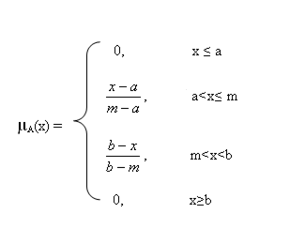
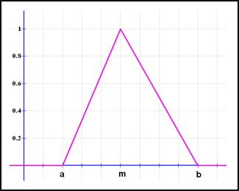
Triangular function: defined by a lower limit a, an upper limit b, and a value m, where a < m < b.
We use 3 parameters in matlab
ornekfis.input(1).mf(1).type='trimf';
ornekfis. input(1).mf(1).params=[0 5 10];

Slide 14
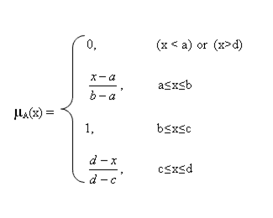
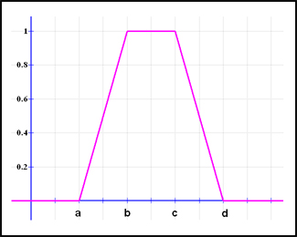
Trapezoidal function: defined by a lower limit a, an upper limit d, a lower support limit b, and an upper support limit c, where a < b < c < d.
we use 4 parameters in matlab
ornekfis.input(1).mf(1).type='trapmf’
ornekfis. input(1).mf(1).params=[-2 0 1 3];

Slide 15
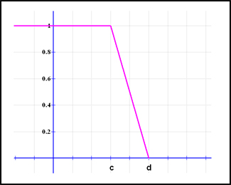
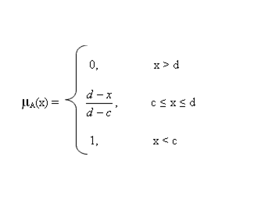
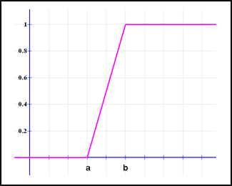
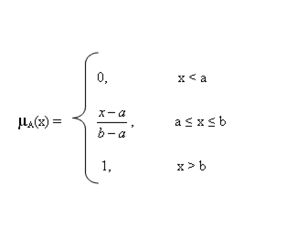
There are two special cases of a trapezoidal function, which are called R-functions and L-functions:
R-functions: with parameters a = b = - ∞
L-Functions: with parameters c = d = + ∞

Slide 16
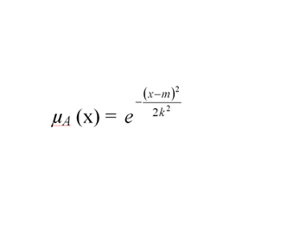
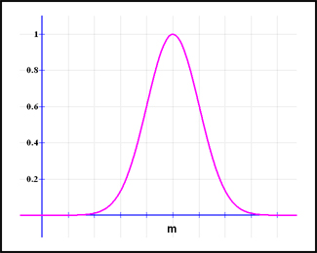
Gaussian function: defined by a central value m and a standard deviation k > 0. The smaller k is, the narrower the “bell” is.
We use 2 parameters in matlab
ornekfis.input(1).mf(1).type='gaussmf’
ornekfis. input(1).mf(1).params=[2 1];

Slide 17
Fuzzy Logic Operators
Suppose we have the following (discrete) fuzzy sets:
A = 0.4/1+0.6/2+0.7/3+0.8/4
B = 0.3/1+0.65/2+0.4/3+0.1/4
The union of the fuzzy sets A and B
= 0.4/1+0.65/2+0.7/3+0.8/4
The intersection of the fuzzy sets A and B
= 0.3/1+0.6/2+0.4/3+0.1/4
The complement of the fuzzy set A
= 0.6/1+0.4/2+0.3/3+0.2/4
Fuzzy Union
Fuzzy Intersection
Fuzzy Complement

Slide 18
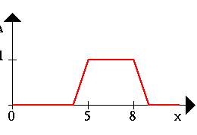
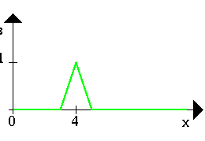
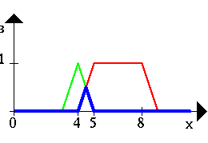
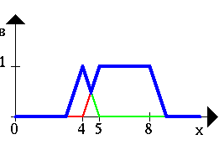
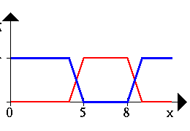
Fuzzy Logic Operators(Cont..)
A ∧ B A ∨ B ¬A

Slide 19
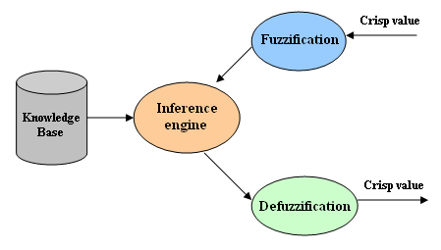
Fuzzy Logic System
Fuzzification module: transforms the system inputs, which are crisp numbers, into fuzzy sets. This is done by applying a fuzzification function.
Knowledge base: stores IF-THEN rules provided by experts.
Inference engine: simulates the human reasoning process by making fuzzy inference on the inputs and IF-THEN rules.
Defuzzification module: transforms the fuzzy set obtained by the inference engine into a crisp value.

Slide 21
Fuzzy IF-THEN rules
In its simplest form, a fuzzy “if-then” rule follows the pattern:
“If x is A then y is B"
A and B are linguistic values defined by fuzzy sets in the universes of discourse X and Y.
x is the input variable and y is the output variable.

Slide 22
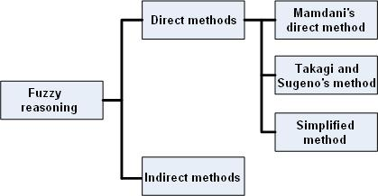
Classification of fuzzy inference methods
Fuzzy inference methods are classified in direct methods and indirect methods. Direct methods, such as Mamdani's and Sugeno's, are the most commonly used (these two methods only differ in how they obtain the outputs). Indirect methods are more complex.

Slide 23
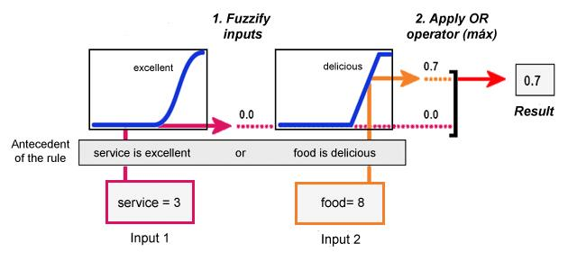
Mamdani’s Method
Step 1. Evaluate the antecedent for each rule
When fuzzifying the first part of the antecedent (service is excellent) we obtain the degree to which the service is excellent if we rate it as a 3. As we can see, a 3 rating stands for a poor service, that is why we obtain the membership value 0. When fuzzifying the second part of the antecedent (food is delicious) we obtain the degree to which the food is delicious if we rate it as an 8. Naturally, an 8 rating stands for a quite delicious food, that is why we obtain the membership value 0.7.
Lastly, as the two parts of the antecedent are joined by a disjunction (service is excellent or food is delicious), we apply an OR operation, the maximum, to both membership values to obtain the membership value 0.7. Let's suppose both parts of the antecedent were joined by a conjunction ('and'). In this case we would have to apply an AND operation, the minimum for instance.

Slide 24
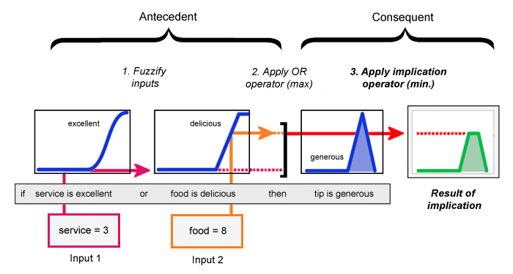
Step 2. Obtain each rule's conclusion
Given the consequent of each rule (a fuzzy set) and the antecedent value obtained in step 1, we apply a fuzzy implication operator to obtain a new fuzzy set.
Two of the most commonly used implication methods are the minimum, which truncates the consequent's membership function, and the product, which scales it. In the example below, the minimum operator is used:

Slide 25
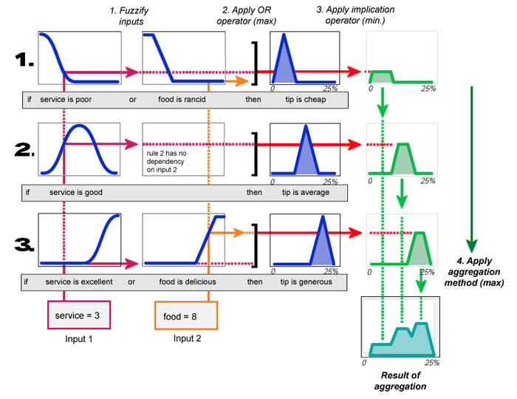
Step 3. Aggregate conclusions
In this step we combine the outputs obtained for each rule in step 2 (obtain conclusion) into a single fuzzy set, using a fuzzy aggregation operator.
Some of the most commonly used aggregation operators are the maximum, the sum and the probabilistic sum. In the example below (obtained fromMatlab's tutorial), the maximum is used:

Slide 26
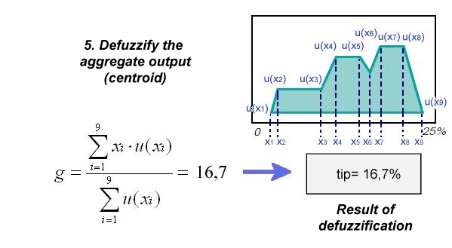
Step 4. Defuzzification
When we try to solve a decision problem, we want the output to be a number (crisp value) and not a fuzzy set. For the tipping problem for instance, we do not want the system to tell us to give a generous tip. What we want to know is how much tip we should give. So, we need to transform the fuzzy set we obtained in step 3 into a single numerical value. One of the most popular defuzzification methods is the centroid, which returns the center of the area under the fuzzy set obtained in step 3. The calculations are shown below:

Slide 27
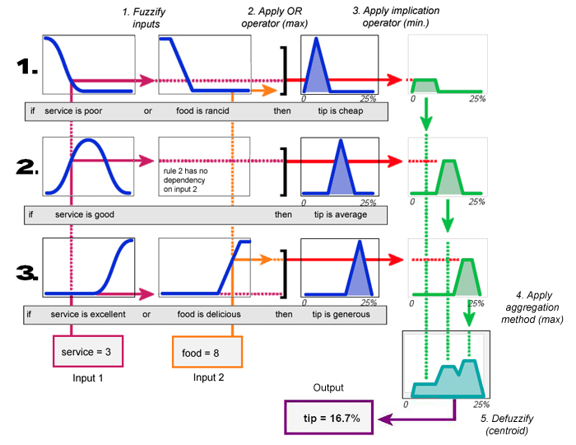
Mamdani’s Method
Shown below is a diagram containing all the steps applied to the tipping problem (obtained fromMatlab's tutorial).

Slide 28
Mamdani’s Method
It is worth mentioning that Mamdani's method is useful when there is a small number of variables. Otherwise, we will find the following difficulties:
The number of rules increases exponentially with the number of variables in the antecedent.
The more rules we construct, the harder is to know if they are suitable for our problem.
If the number of variables in the antecedent is too large, it will be difficult to grasp the casual relationship between the antecedents and the consequents. Therefore, constructing new rules will become harder.
There are other methods that try to solve these difficulties, such as Sugeno's method.

Slide 29
Sugeno’s Method
It is similar to the Mamdani method in many respects. In fact the first two parts of the fuzzy inference process, fuzzifying the inputs and applying the fuzzy operator, are exactly the same. The main difference between Mamdani-type of fuzzy inference and Sugeno-type is that the output membership functions are only linear or constant for Sugeno-type fuzzy inference.
A typical fuzzy rule in a zero-order Sugeno fuzzy model has the form
if x is A and y is B then z = k
where A and B are fuzzy sets in the antecedent, while k is a crisply defined constant in the consequent. When the output of each rule is a constant like this, the similarity with Mamdani's method is striking. The only distinctions are the fact that all output membership functions are singleton spikes, and the implication and aggregation methods are fixed and can not be edited. The implication method is simply multiplication, and the aggregation operator just includes all of the singletons.

Slide 30
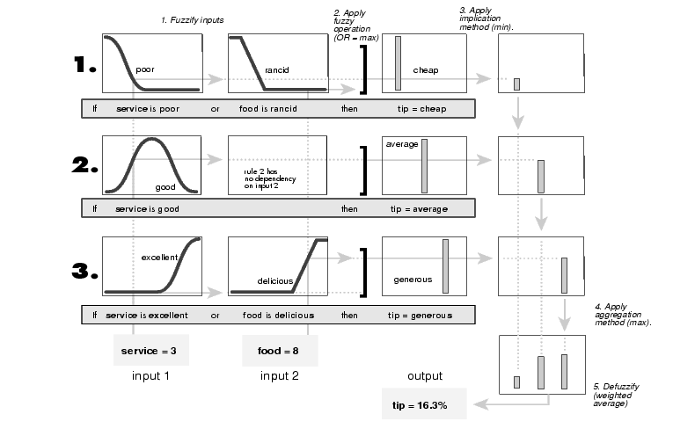

Slide 31
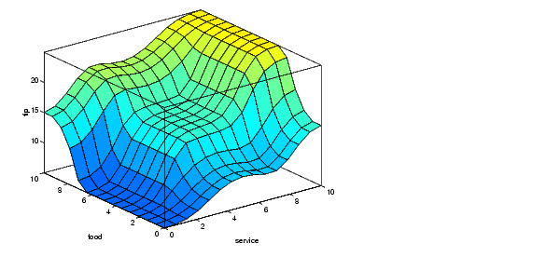
The figure above shows the fuzzy tipping model developed in previous sections of this manual adapted for use as a zero-order Sugeno system. Fortunately it is frequently the case that singleton output functions are completely sufficient for a given problem's needs. As an example, the system tippersg.fis is the Sugeno-type representation of the now-familiar tipping model. If you load the system and plot its output surface, you will see it is almost the same as the Mamdani system we've been looking at. a = readfis('tippersg');
gensurf(a)

Slide 32
Applications
ABS Brakes
Expert Systems
Control Units
Bullet train between Tokyo and Osaka
Video Cameras
Automatic Transmissions

Slide 33
Advantages of Fuzzy Logic
Mimicks human control logic
Uses imprecise language
Inherently robust
Fails safely
Modified and tweaked easily

Slide 34
Disadvantages of Fuzzy Logic
Operator's experience required
System complexity

